Slide 1

Internship: Final Presentation
September 9, 2019
Intern: XU ZHIYUN
Supervisor: Mr. Serge Lasserre

Slide 2
Contents
Introduction
Recoding of BM3D
Integration into the tools
Results
Acknowledgement

Slide 3
Introduction
Internship Duration : 3 months (17th June -13th Sept 2019)
Objective :
To convert a public algorithm “BM3D” from C++ to C and integrate it into a tools to analyze the limitations of the tools and to improve it
Tasks :
• Integration of the “BM3D” in the tool (recoding from C ++ to C, taking into account specific "C" constraints)
• Analysis of behavior, limitations and results obtained
Notes:
The aim of this three-month internship is to leverage cutting edge research to automatically optimize the precision of operators in complex algorithms and find the best tradeoff between cost/power and picture quality.
To achieve this, a public Image Denoising Algorithm "BM3D" written in C++ was previously selected for the evaluation. However the tools don’t support C++, so the first phase is to understand the algorithm and do the recoding from C ++ to C respecting constraints of the tools, then integrate it into the tools. The second phase is to do some explorations and to analyze the result obtained.

Slide 4
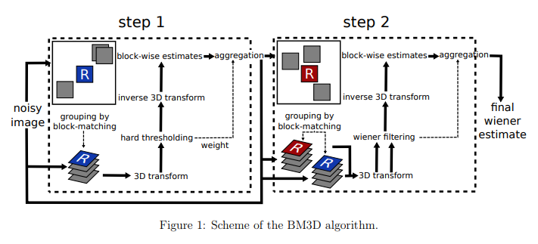
Introduction
BM3D (Block-matching and 3D filtering) :
• BM3D is based on the fact that an image has a locally sparse representation in transform domain. This sparsity is enhanced by grouping similar 2D image patches into 3D groups.
• Collaborative filtering is a special procedure developed to deal with these 3D groups by using the three successive steps: 3D transformation of 3D group, shrinkage of transform spectrum, and inverse 3D transformation.
• Aggregation is a particular averaging procedure used to take advantage of redundancy.
[1]
Notes:
Then I’ll introduce the principles and processes of BM3D. BM3D is based on the fact that an image has a locally sparse representation in transform domain….
The algorithm has two major steps which are summarized in the Figure 1. These two steps have almost the same processes, the difference is that the first step uses hard thresholding during the collaborative filtering, the second step uses Wiener filtering and it’s based both on the original noisy image, and on the basic estimate obtained in the first step. I’ll present more details in the next part.

Slide 5
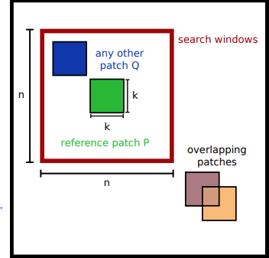
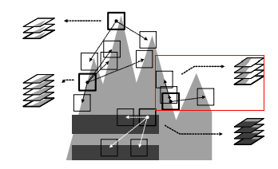
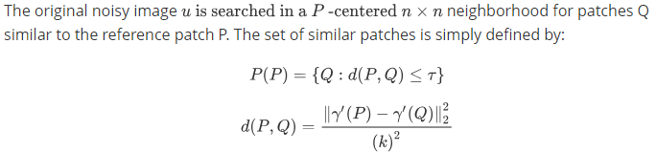
Recoding of BM3D
• Grouping
Notes:
The first sub-step of BM3D is grouping which took me a lot of time to understand and to recode at the beginning. It is very similar to the algorithm BM3D, the original noisy image u is searched in a …. The 3D group, is then built by stacking up the matched patches. In order to speed up the process, the first step keep only 16 patches that are closest to the reference patch,32 patches for the second step.

Slide 6
Recoding of BM3D
• Grouping code
Difficults :
Lack of experience and the complexity of the source code
C limitations : doesn’t have template (vector<>, pair<>)
Notes:
Starting the recoding with this part, I had somes difficults : In fact, it wat the first time that I faced a project with about four thousand lines of code, and I hardly used C Language in school, this part has too many loops and uses the method of the integral images. And the differences between C language and C++ also gave me some limitations, for example C doesn’t have template like vector<>, many functions must be rewrited. So it was a great challenge. I finished that by solving the problem step by step. I divided the function into three parts, then tested and debugged every time a part was complete to ensure that the results are correct.

Slide 7
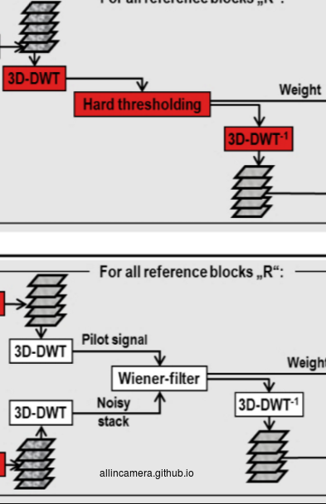
Recoding of BM3D
• Collaborative Filtering
Once the 3D-block is built the collaborative filtering is applied. A 3D transform(2D+1D) is applied to the group, followed by a shrinkage of the transform spectrum. Finally the inverse transform is applied to estimate for each patch.
Advantages:
- Can enhance the sparsity of patches.
- By attenuating the noise, collaborative filtering reveals even the finest details shared by the grouped patches.
Notes:
Once the 3D-block is built the collaborative filtering is applied. A 3D isometric linear transform is applied to the group, followed by a shrinkage of the transform spectrum. Finally the inverse transform is applied to estimate for each patch. This method can enhance the sparsity of patches and by attenuating the noise, it reveals even the finest details shared by the grouped patches. Why?

Slide 8

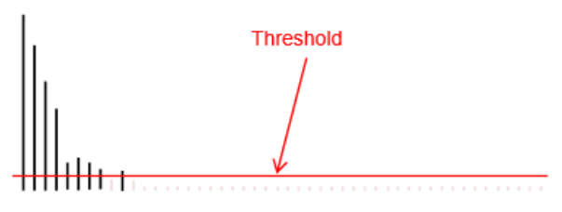

Recoding of BM3D
• Collaborative Filtering
It uses frequency domain techniques, an image is transformed to the frequency domain and then the filtering operations are performed there, and the resulting denoised signal is transformed back into the spatial domain.
The noise-free signal looks smooth
In a transform domain (frequency domain)
Noisy signals looks rough
Notes:
It uses frequency domain techniques, an image is transformed to the frequency domain and then the filtering operations are performed there, and the resulting denoised signal is transformed back into the spatial domain. The noise free signal looks smooth, the noisy signals look more rough. The idea is to transform the signal from space domain to transform domain at first, and then set a threshold, the part above the threshold is the noise then remove it. The noise can be divided into high, middle and low-frequency noise. With this transform domain method, the different frequencies noise can be separated and then effectively removed. BM3D used DCT and wavelet transform method.

Slide 9
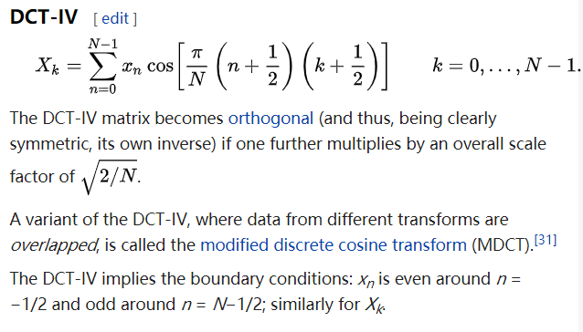




Recoding of BM3D
• Collaborative Filtering code
Difficults :
Rewrite the DCT transform
For the transform coefficient matrix
For matrix to be converted
DCT2d:
Inverse DCT2d:
Notes:
The source code used a library fftw3 to implement the DCT transform which is not support by the tools. So I had to rewrite the whole DCT transform without reference code, it was difficult. Fortunately, Mr. Denis helped me, he told me that the transform can be written in matrix form, and it helped me a lot.

Slide 10
Recoding of BM3D
• Collaborative Filtering
Once the 3D-block is built the collaborative filtering is applied. A 3D transform(2D+1D) is applied to the group, followed by a shrinkage of the transform spectrum. Finally the inverse transform is applied to estimate for each patch.
Advantages:
- Can enhance the sparsity of patches.
- By attenuating the noise, collaborative filtering reveals even the finest details shared by the grouped patches.
Notes:
Once the 3D-block is built the collaborative filtering is applied. A 3D isometric linear transform is applied to the group, followed by a shrinkage of the transform spectrum. Finally the inverse transform is applied to estimate for each patch. This method can enhance the sparsity of patches and by attenuating the noise, it reveals even the finest details shared by the grouped patches. Why?

Slide 11
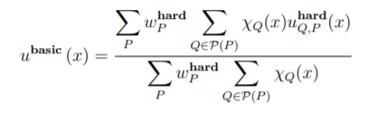
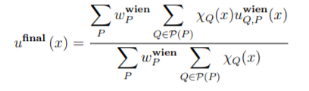
Recoding of BM3D
• Aggregation
Blocks after Collaborative Filtering are overlapping, for each pixel we obtain many different estimates which need to be combined. Aggregation is a particular averaging procedure which is exploited to take advantage of this redundancy.
The basic estimate after this first step is given by
The final estimate obtained after the second step is given by
Notes:
When the collaborative filtering is done, the next step is aggregation. Because these blocks after step Collaborative Filtering are overlapping, for each pixel we obtain many different estimates which need to be combined. Aggregation is a particular averaging procedure which is exploited to take advantage of this redundancy.

Slide 12

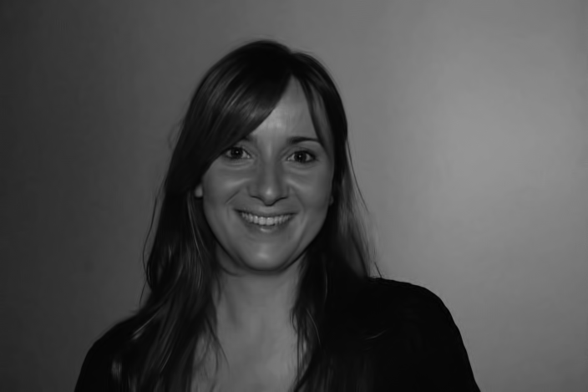
Recoding of BM3D
• Result
To reduce the exploration time, we process only grayscale PNG images.
PSNR: 40.659636, SSIM: 0.956725
Noisy image Denoised image
Notes:
To reduce the exploration time, we process only grayscale PNG images. This is the result, on the left is the noisy image, the right is denoised image. The PSNR and SSIM obtained by compare to the original image, signify a good quality of denoised image.

Slide 13
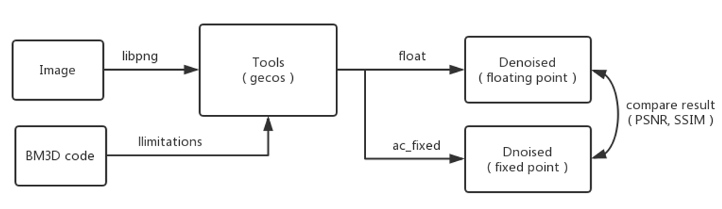
Integration into the tools
Scheme of tools
Notes:
This is the scheme of tools.
At the beginning, I had some troubles with the installation environment, it took me some time to find the correct version of libpng and the tools had some compile errors, we changed the version to Stable-Clean to solve the problem. Also, the tools had some limitations

Slide 14
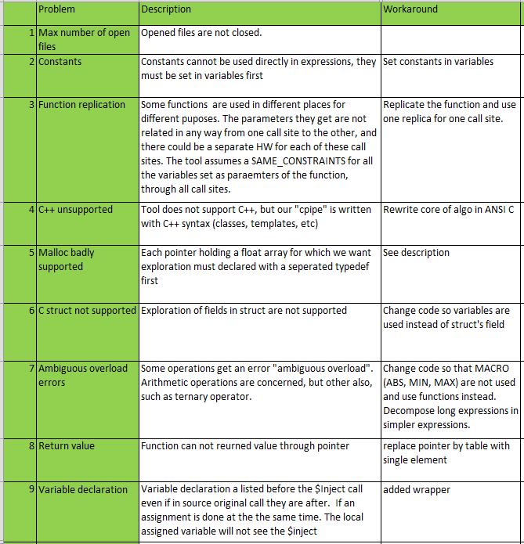
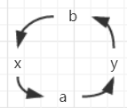


Limitations of tools
Void toto( float x, float y);
float a,b;
toto(a,b);
Type a=x, b=y;
toto(b,a);
Type b=x=a=y=b;
Error : cycles with SAME constraints
Solution :
Replicate the function
DCT2d:
Inverse DCT2d:
Notes:
Also, the tools had some limitations as we can see in the tableau. Most of the problems have been solved while the recoding, but the third problem was not obvious until I ran the tools. In fact, for every function call, the exploration flow automatically constrains the function parameters to have the same number representation as the input arguments at the callcite. For example : toto()….. In the code, dct2d…..

Slide 15
Integration into the tools
Normalization :

Slide 16
Results:

Slide 17
References:
1. Lebrun M. An Analysis and Implementation of the BM3D Image Denoising Method[J]. Image Processing on Line, 2012, 2(25):175-213.

